Slide 1



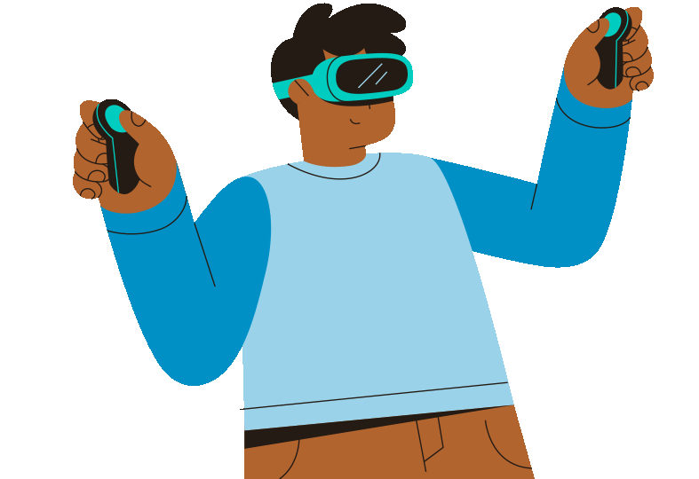

DES643 - GROUP PROJECT
THE PIXEL ARCHITECTS
MEDITATION VR

Slide 2



CONTENTS
1
The Team
5
Dev Challenges
2
Introduction
6
Future Goals
3
Our Aim
7
Summary
4
Design Flowchart

Slide 3


THE TEAM
SIDHANT THALOR
ROHAN NIMESH
ADITI VERMA
SARTHAK PASWAN
SANSKAR YADUKA
DIPENDRA SINGH

Slide 4



INTRODUCTION
This project was conceived with the aim of creating a Virtual Reality application tailored specifically for users seeking moments of tranquil meditation within a virtual environment. By immersing users in serene virtual spaces, the app strives to cultivate a sense of calmness and promote psychological well-being. Through the utilization of immersive technology, the application seeks to provide users with a transformative experience conducive to relaxation and mental rejuvenation.

Slide 5
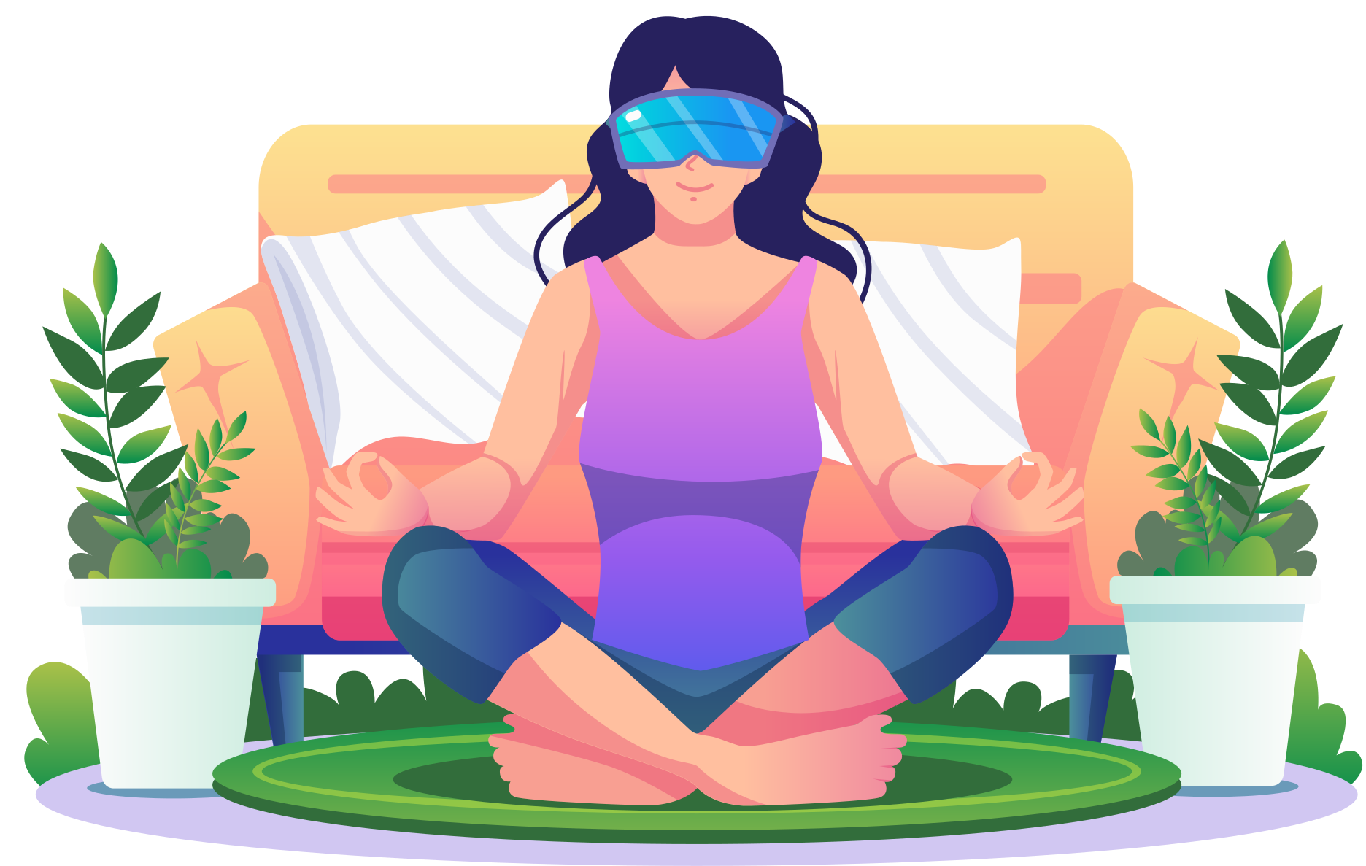
OUR AIM
We aimed to develop a virtual reality environment that can help the user meditate using guided meditation techniques, explore different breathing styles and put them into practice in an environment that feels natural and scenic while at the comfort of their home.
We wanted the app to be the best way possible for users to feel relaxed, improve their focus and concentration and reduce their stress.

Slide 6

DESIGN FLOWCHART
start page
Quit Button
Play
Settings
Quit
Setting Button
Back Button
Game End
Volume Settings
back
Play Button
5 min meditation
12 min meditation
World Select
Main Menu
Meditation Type
Return To Main Menu
World 1
World 3
World 2
Pause/Resume
World swap
Quit
Pause/Resume
World swap
Quit
Pause/Resume
World swap
Quit
Swap
Swap

Slide 7

DEVELOPMENT CHALLENGES
So there were a bunch of challenges we faced while trying to build this VR experience. Those include -
Not having a VR device, the XR Device Simulator and XR Interaction Toolkit came in handy
Many prefabs that we wanted weren’t available online, we tried to build some using Blender and Unity Asset Store was a great help
Making an Open World VR Meditation Experience needed a lot of things to set in the right place, luckily they did, and we were able to come up with a great app.

Slide 8
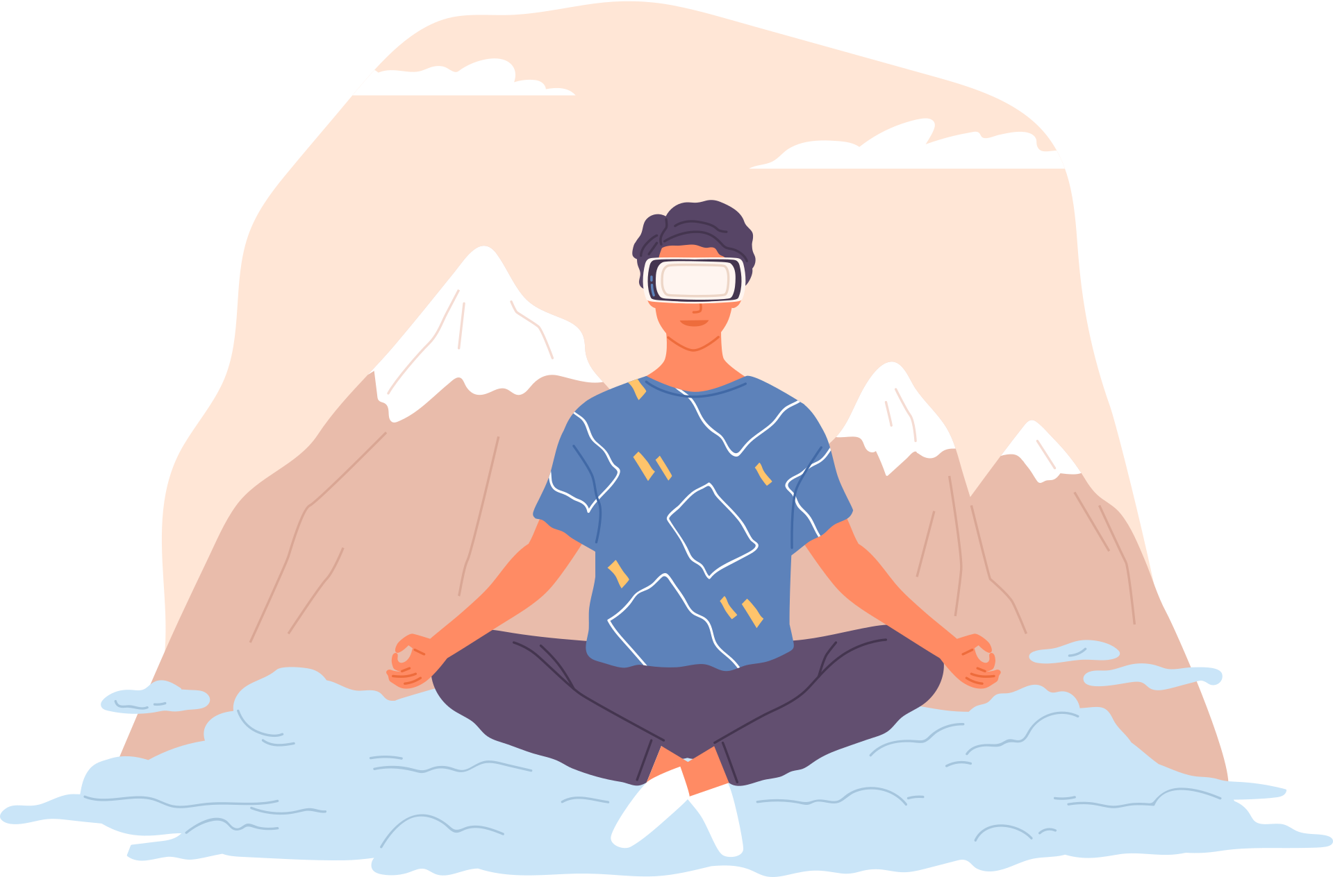
FUTURE GOALS
We had a bunch of goals for the future:
We plan to add more virtual environments (we had another virtual environment half-ready where we planned to give the user an open world to relax and explore instead of guiding them in meditating; in this forest world, the environment has calming sounds which sends calm waves to the user’s brain)
We also plan to add a Stress level monitoring and Heart rate monitoring column using the Stats section (we did try to write a script for this, but because of not having a VR device, we couldn’t test it out completely)
We would also love to collaborate with Mental Health Professionals and work more on what our app can offer for the betterment of society

Slide 9

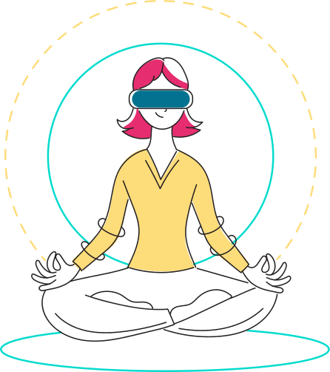
SUMMARY
VR Meditation, how we envisioned it, was a revolutionary idea to bring the calmness of meditation to those who want to escape distractions, become more focused and less stressed or the ones who just want to explore themselves from within. Meditation using a VR device offers a lot of customizable experiences tailored to individual preferences and needs, such as guided sessions, breathwork exercises and ambient environments. Continued research, development, and refinement of our VR Meditation system will be fruitful for the user.

Slide 10

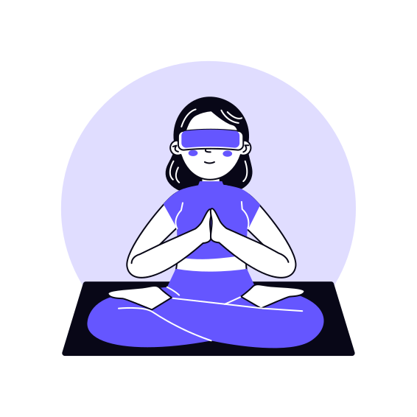

THANKS FOR YOUR TIME!
HOPE YOU LIKED OUR PROJECT

